Slide 1



Mechanisms and Indicators for Determining Progress and SIG Renewal
Featuring:
Kim Benton, Mississippi Department of Education
Jayne Green and Kyron Jones, Arkansas Department of Education

Slide 2
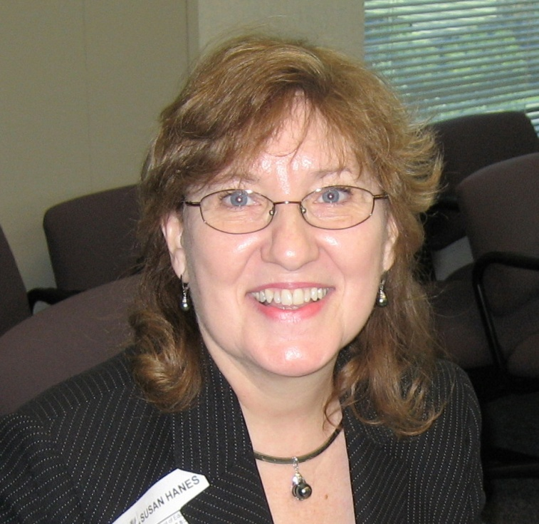
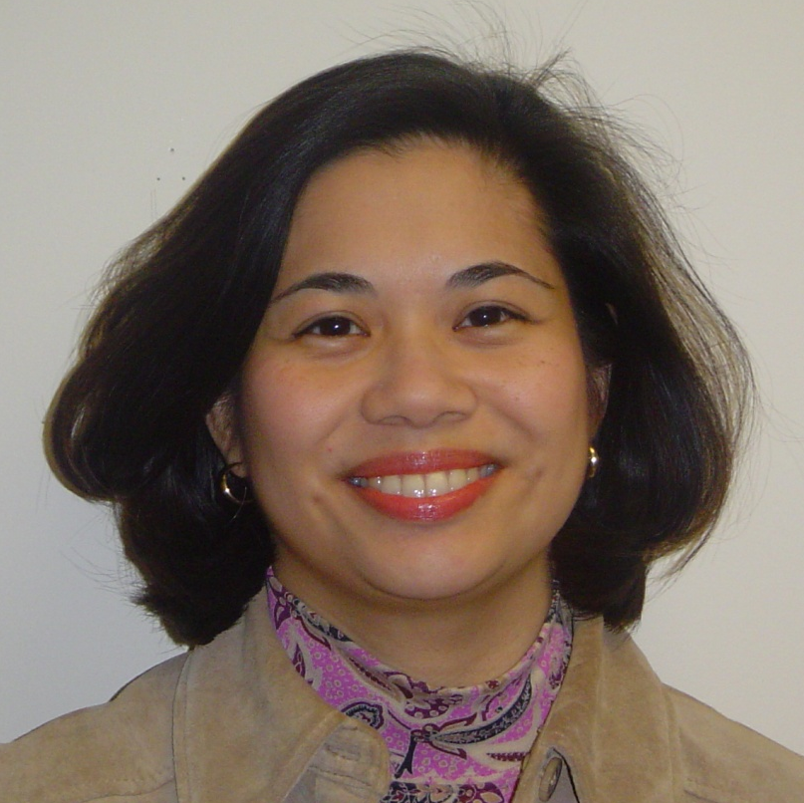
NNSSIL Co-coordinators
Susan Hanes
Technical Advisor, Center on Innovation and Improvement
Nina de las Alas
Program Director, Council of Chief State School Officers
Notes:
2

Slide 3
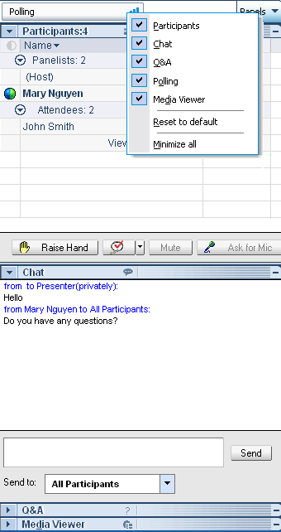
WebEx Panels & Features
Participants
Raise/lower hand
Chat
Q&A
Notes:
3

Slide 4
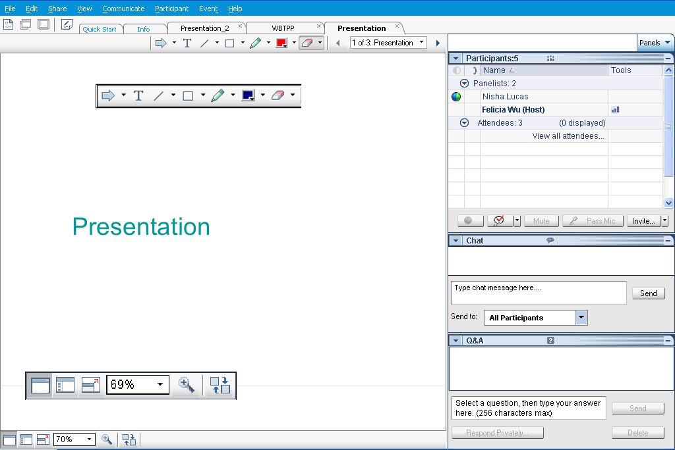
Webex Panels & Features
Presentations
Visual magnification
Audio volume (manual control through your phone or if using VOIP through computer’s audio controls . If you still cannot hear, please send Nina a chat message) or contact WebEx Tech Support (866-229-3239).
Notes:
4

Slide 5
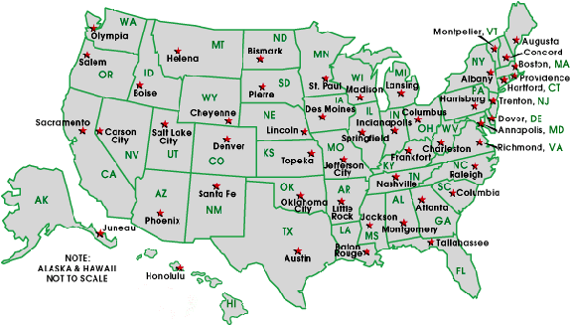
National Network of State School Improvement Leaders (NNSSIL)
Membership
50+ SEAs and territories
16 Regional Comprehensive
Centers (RCCs) & 5 Content
Centers
Advisory Group – Design Team
Subgroup of state reps., sub-dir.-level RCC
staffers, US ED, and NNSSIL co-coordinators
Administrative Partners
Center on Innovation & Improvement
Council of Chief State School Officers
More information: http://www.centerii.org/leaders

Slide 6
Mechanisms and Indicators for Determining Progress and SIG Renewal
Purpose
Present Arkansas’ and Mississippi’s efforts in determining progress and renewal
  Identify tools and resources the state education agency (SEA) uses to monitor SIG schools
  Recount lessons learned as the SEAs’ policies and practices have evolved
  Share best practices
  Discuss how the SEAs determine progress and makes decisions on renewal
  Highlight ongoing issues, challenges, and points to consider
Field questions from participants

Slide 7
Featured Presenters

Slide 8
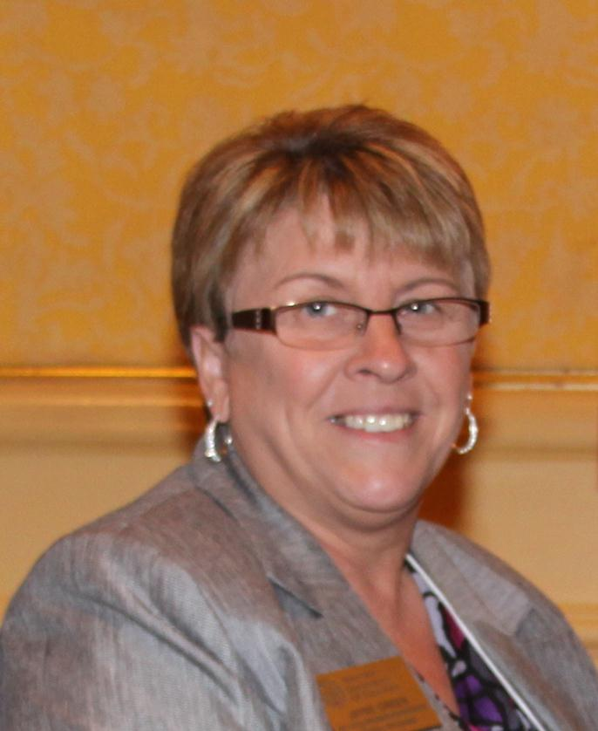
Featured Presenters
Jayne Green
SIG Program Administrator, Federal Programs Unit-Division of Learning Services
Arkansas Department of Education

Slide 9
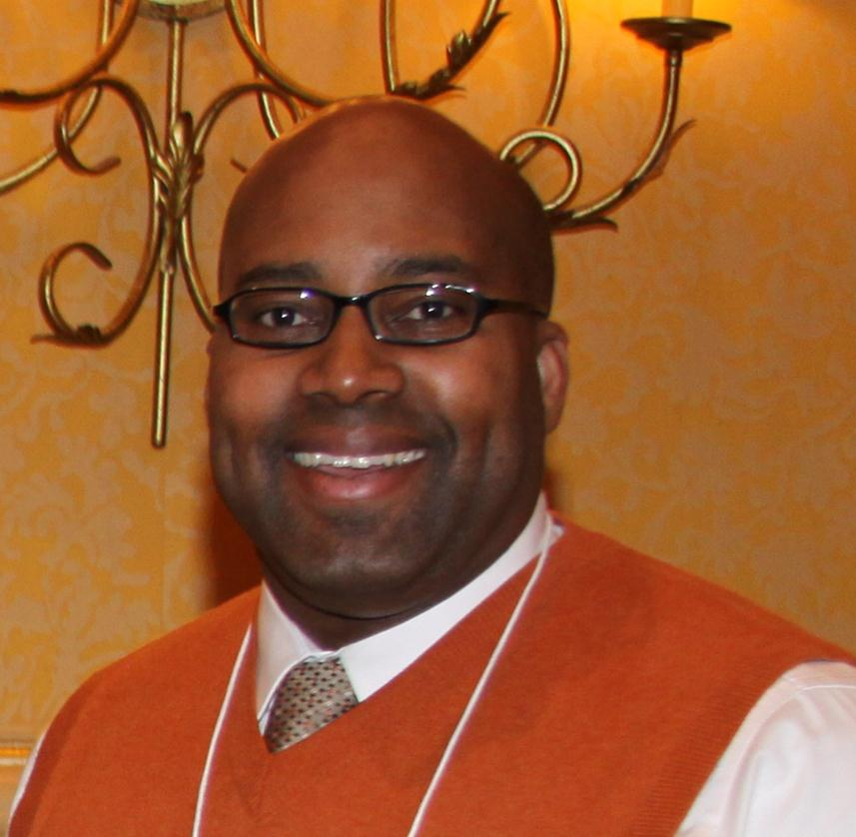
Featured Presenters
Kyron Jones
SIG Site Director, Federal Programs Unit-Division of Learning Services
Arkansas Department of Education

Slide 10
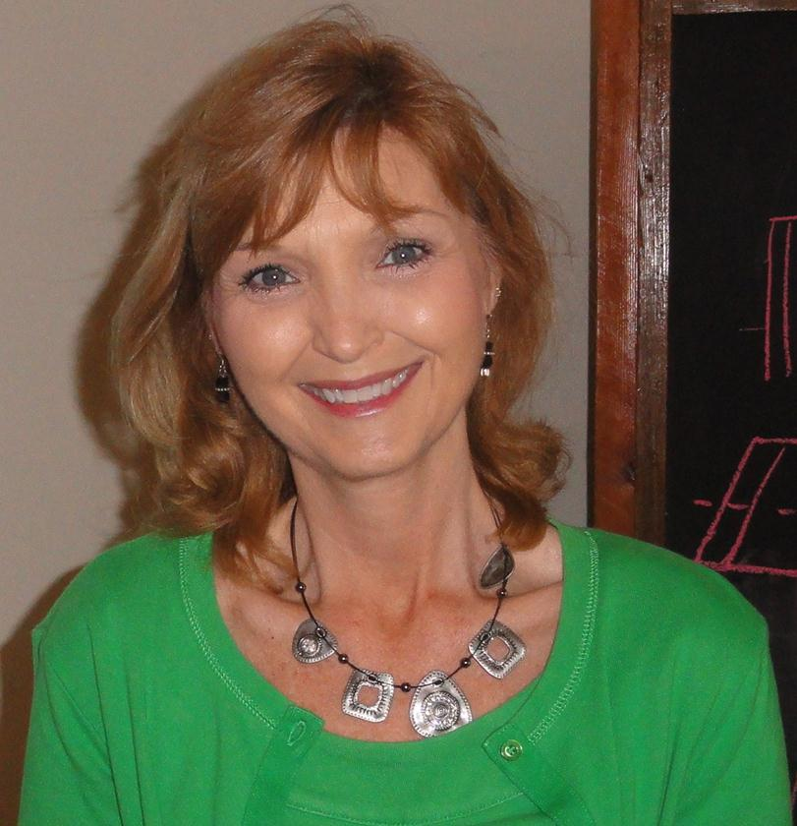
Featured Presenters
Kim Benton
Bureau Manager, Office of School Recovery
Mississippi Department of Education

Slide 11
Q & A and Discussion

Slide 12
Q & A and Discussion
Please note that your phone line is muted upon entry and will remain muted (see red x in front of your name)
To get speakers’ attention, please use the “Raise Hand” button in the Participants Panel. We will un-mute then.
You can also post your questions or comments on the Q & A Panel.
Notes:
12

Slide 13
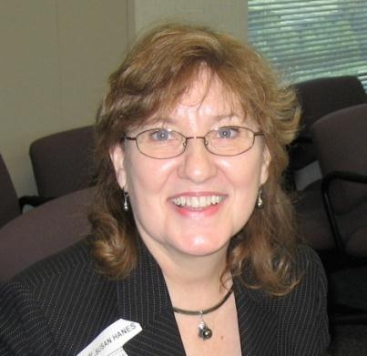

Panelists
Susan Hanes
NNSSIL Co-Coordinator/
Moderator
Jayne Green
Arkansas DOE
Kim Benton
Mississippi DOE
Kyron Jones
Arkansas DOE
Notes:
13

Slide 14
For More Information www.centerii.org/leaders
Link to this webinar’s recording, slides and resources mentioned during the presentations
Feedback
Follow-up questions? Send to Susan Hanes, shanes@centerii.org

Slide 15

Thank you to our featured presenters and thank you all for participating in today’s webinar!
Notes:
15

